Slide 1
MARUTI SUZUKI FINANCE FILMS

Slide 2
About :
Maruti Suzuki, India’s largest carmaker, has launched an easy-to-use online platform to offer customers end to end car finance related services. Maruti Suzuki Smart Finance is a ONE-STOP SHOP for all Maruti Suzuki customers, where they can find myriad solutions for all their auto finance related needs. This includes finding the right finance partner, choosing the best loan option for their Maruti Suzuki ARENA car, completing related formalities, and disbursal of loan online as the platform acts as a facilitator between the financier and the customer.
Maruti Suzuki Smart Finance is where car finance becomes simple and hassle-free. Whether you are looking for the best car finance deals when buying a new Maruti Suzuki ARENA car or customised car loan offers; you will find everything you need at Maruti Suzuki Smart Finance.
Brief :
With this new and simplest way of finance they wanted TVC route which is emotional yet connects to large Martui audience.

Slide 3
IDEA-1: WEDDING GIFT FOR DAD

Slide 4




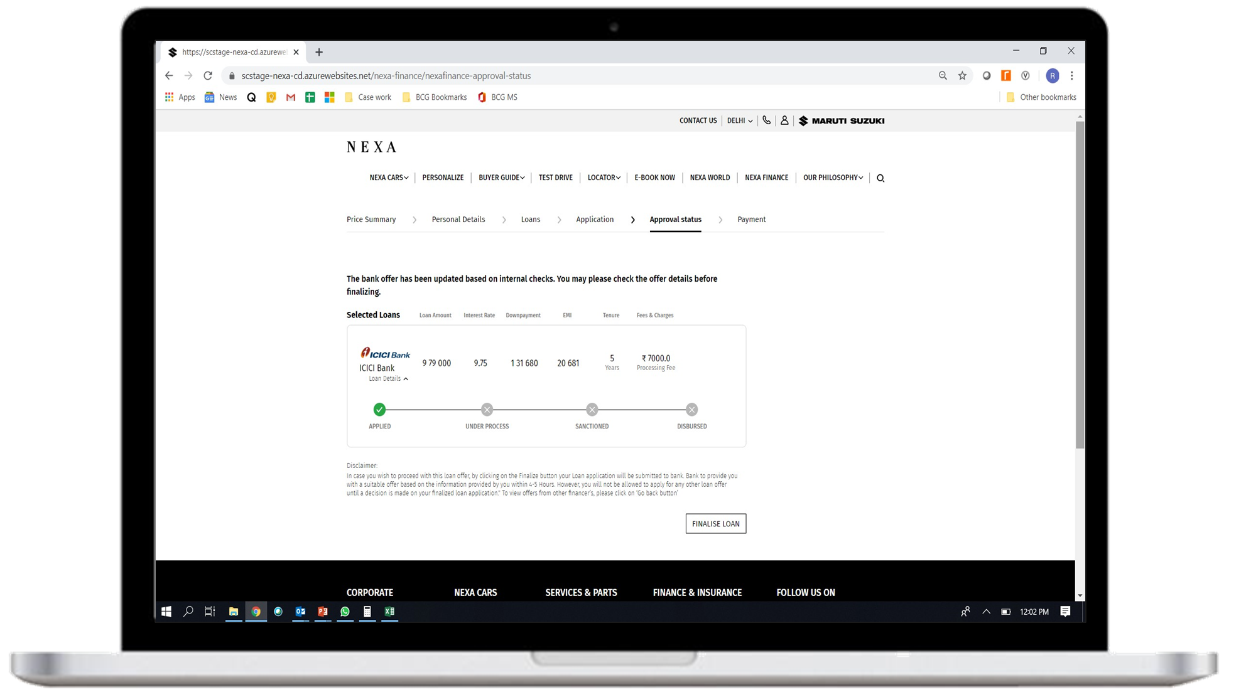


The film is about a daughter who is secretly planning to gift her dad a car on her wedding because she will be taking her car away.
So we see how even when she is busy with wedding preparations, she is easily able to finance the car with MS finance.
As the VO talks about each of the RTBs they appear on the screen. We cut to the daughter busy in managing wedding, she easily apply for online loan application she gets digital sanction letter, and the screen then says
‘Congratulations!’
Vo- Maruti Suzuki Finance deta hai aapko multiple banks ke options, customizable offers, pre approved loans, aur digital document verification!
After the wedding when she is leaving, we see daughter giving this surprise to her dad.
“Mai to apni gaadi leke jaa rahi hun, ye aapki.”
She gives her dad the keys to his new car.
VO- Jab MS Finance ke easy 4 steps banye gaadi finance karna itna aasan, to karo har tyohar ki easy shuruat.
Smart Finance
Easy hai

Slide 5
IDEA-2: KUCH EASY KARTE HAI
These series of films revolve around how people are really busy in the festive season and it can get hectic. But there is always a smart and easy way to do things. Like MS finance, the easy way to finance your car.

Slide 6
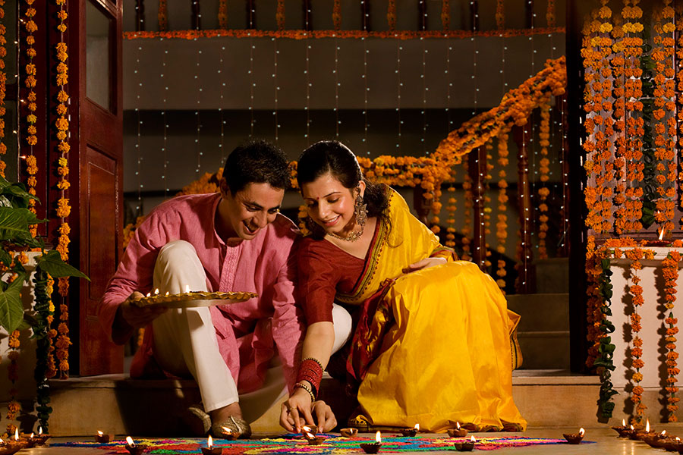

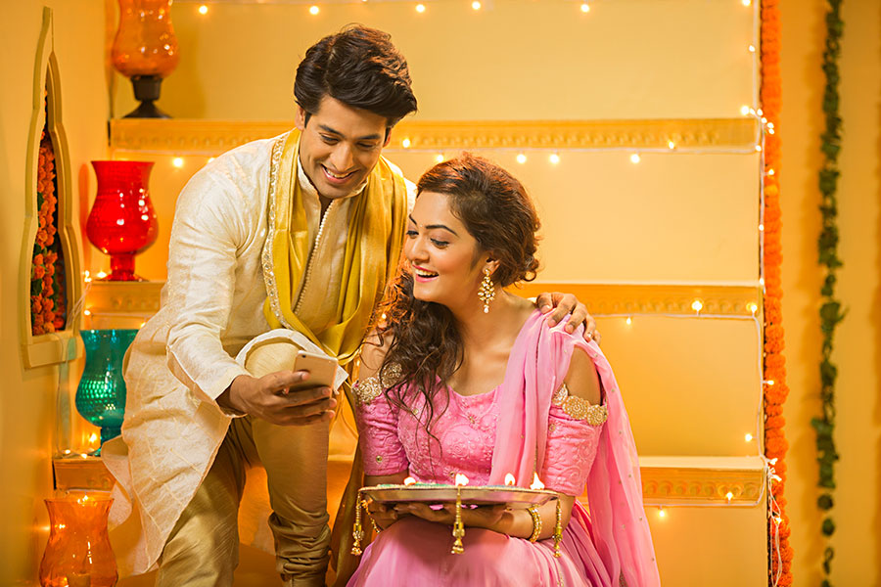

FILM 1-RANGOLI
The film starts with woman (wife) preparing and being busy with her rangoli design when we see her husband just comes and sticks a rangoli sticker saying:
“kuch easy karte hai”
Maruti Suzuki Finance 4 simple steps deta hai aapko multiple banks ke options, customizable offers, pre approved loans, aur digital document verification!
As the VO talks about each of the RTBs they appear on the screen. We cut to the the couple busy in decoration and they easily apply for online loan application they gets digital sanction letter, and the screen then says
‘Congratulations!’
VO- Is diwali kuch easy karo.
Jaise MS finance ke sath ghar baithe gadi finance
karna hai bilkul easy.
We see them welcome home their new car.
Smart Finance
Easy hai

Slide 7






FILM 2 - GET TOGETHER
The film opens on 2 guys sitting at home and we see a lot of Diwali gifts around them. One guy says-
“ab inko dene sabke ghar jana padega,”
To this his brother says
“kuch easy krte hai”
he puts up a message to friends saying-
“Hey come and check out my new car.”
Cut to we see all the friends gathered at his house, and they give the gifts to everyone at the same time.
Maruti Suzuki Finance 4 simple steps deta hai aapko multiple banks ke options, customizable offers, pre approved loans, aur digital document verification!
As the VO talks about each of the RTBs they appear on the screen. We see shots of the guy on his laptop and he easily apply for online loan application he gets digital sanction letter, and the screen then says
‘Congratulations!’
VO- Iss diwali kuch easy karo.
Jaise MS finance ke sath ghar baithe gadi finance
karna hai bilkul easy.
Smart Finance
Easy hai

