Slide 1
SUZUKI GIXXERS FILMS -Pitch

Slide 2
CONCEPT -1
FASTER THAN GOSSIP
There are things something, like gossip, that are fast. Suzuki GIXXER is faster.

Slide 3

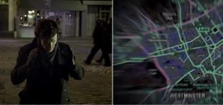


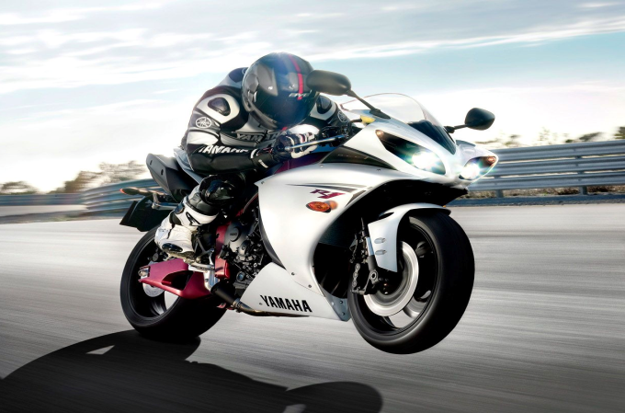


The film starts with two college guys,
where one showing his phone to other.
He sees that there is a picture of him with
a girl. And he starts thinking.
He starts picturing how this can spread fast from one to another and will reach to
his girlfriend. (We see his girlfriend with gun)
Visual reference: Sherlock map scene
He starts his bike and we see some driving shots of fast Gixxer.
He reaches home where his girlfriend stares him with phone in her hand.
She asks him to click selfie and he grabs her phone. Message pops and he deletes it.

Slide 4

GOSSIP IS FAST
BUT GIXXER SF250 IS REALLY FAST.

Slide 5


Slide 6
CONCEPT -2
RITES OF PASSAGE
The rites of passages are important life event which can be marked with some special places, things, feelings or people, which has made/seen or influenced us to move/grow to our next phase.

Slide 7
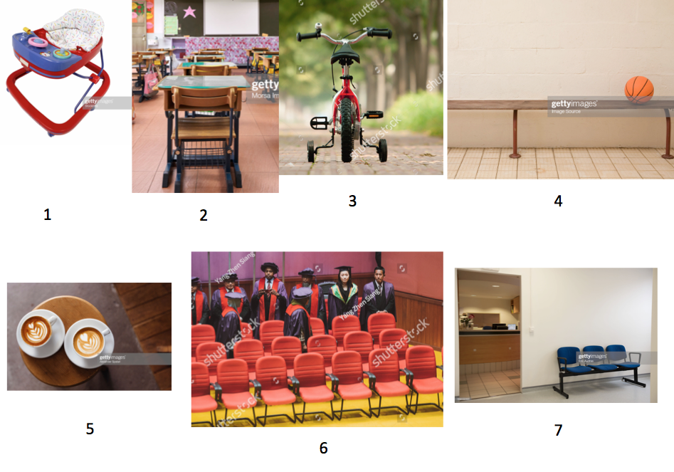
Often the seats, different seats which played important role in our journey in the passage of life will be shown,we will show only seats(zoom in view) from different stages ending into suzuki bike seat. Basically stating how suzuki seat is what makes one complete.
Frame1: zoom in shot of baby walker
(boy crawling towards)
Frame2: shot of primary school bench
(boy entring classroom)
Frame3: first bycycle
(boy looking back to dad who not anymore holds his seat, finally learns to ride)
Frame4: match waiting area bench
(Teeange get a call out and runs towards court)
Frame5: coffee date seat
(waiting for girl)
Frame6: graduation day seat
(leaves his seat for stage)
Frame7: office reception waiting area
(just getsinside and watched the waiting area sofa)
And so on ending with suzuki seat.
Man walking towards Gixxer.

